Slide 1


MIDTOWN AREA TRANSPORTATION PLAN
CRPTA BOARD BRIEFING
February 20, 2018

Slide 2

What We are Doing
Analyzing traffic trends and patterns
  Into, out of, and through the Midtown area
Identifying network deficiencies in the Midtown area
Evaluating potential transportation improvement alternatives
Goal of Phase 1:
  Obtain feedback from CRTPA committees and Board
  Identify viable alternatives for further study and stakeholder review

Slide 3
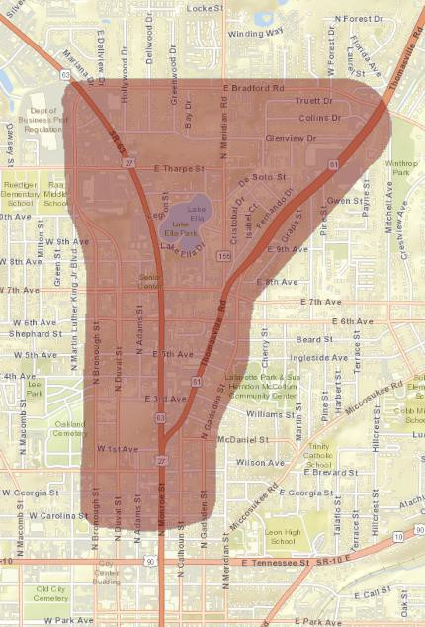
Study Area
Study Area

Slide 4
Review Previous Studies
Blueprint
  Midtown Placemaking
Tallahassee/Leon County Planning Department
  Midtown Action Plan
FDOT District 3 Safety Office
  SR 61/Thomasville Road Pedestrian/Bicyclist Arterial Safety Study
  SR 61/Thomasville Road Supplemental Safety Study

Slide 5
Data Collection
Signal timings, turning movement volumes, etc. – City of Tallahassee
Sidewalk Network – Tallahassee/Leon County Planning Department
Roadway Information – FDOT
Crash Data
Origin-Destination (OD) Data

Slide 6
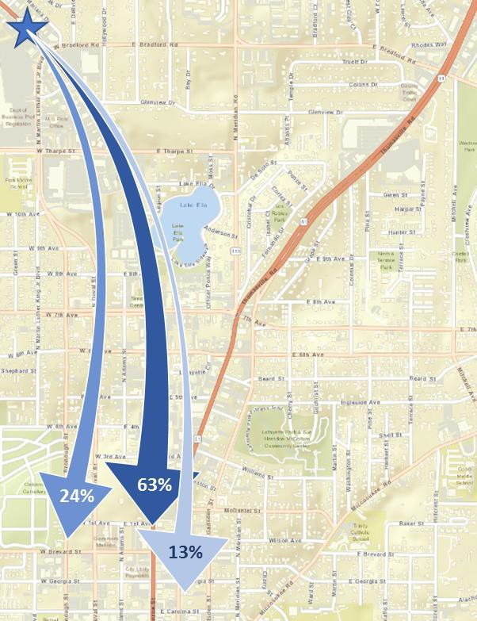
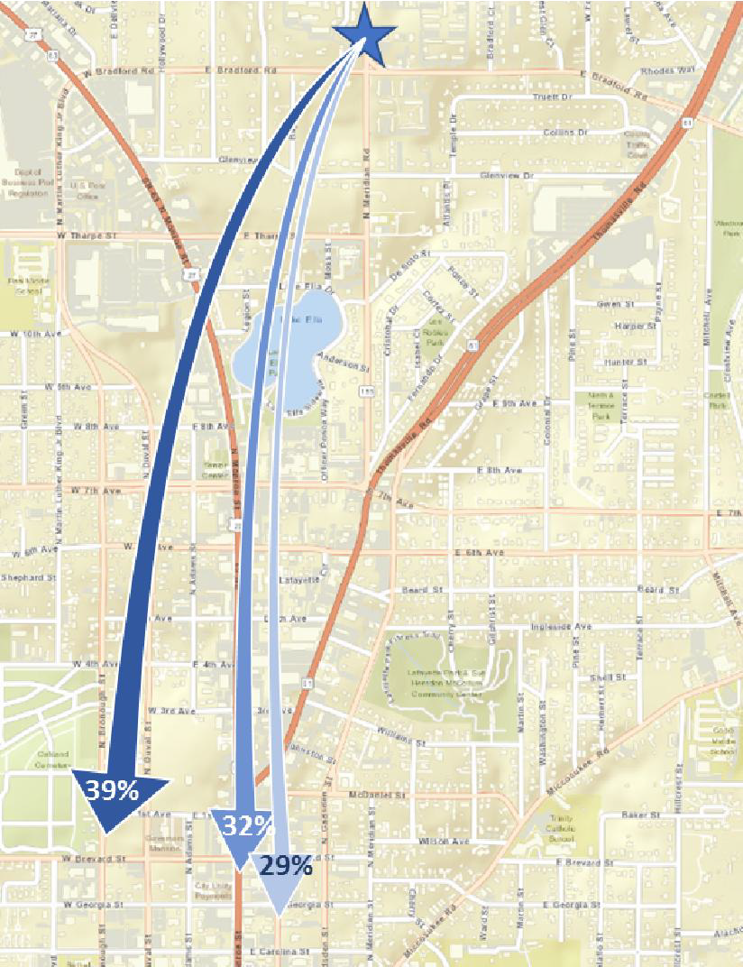
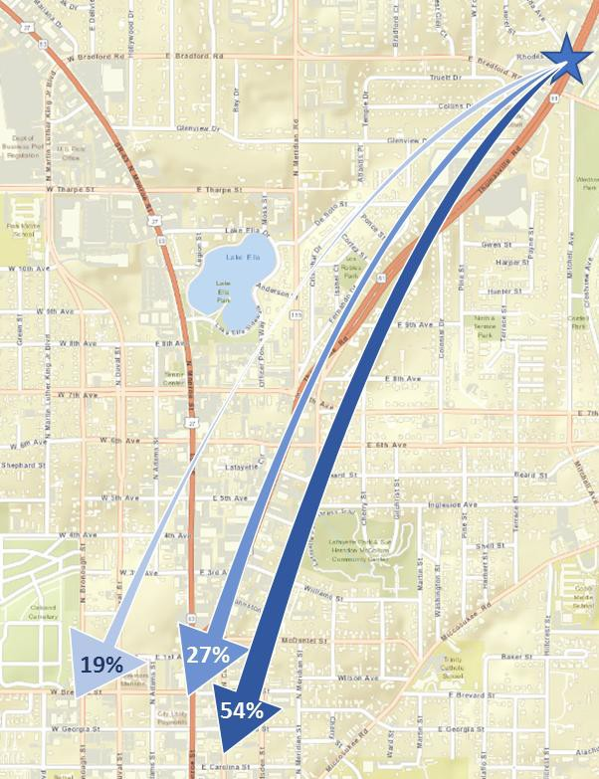
AM Peak Traffic Patterns (weekday)
Origin Northwest (N Monroe St)
Origin North (Meridian Rd)
Origin Northeast (Thomasville Rd)

Slide 7
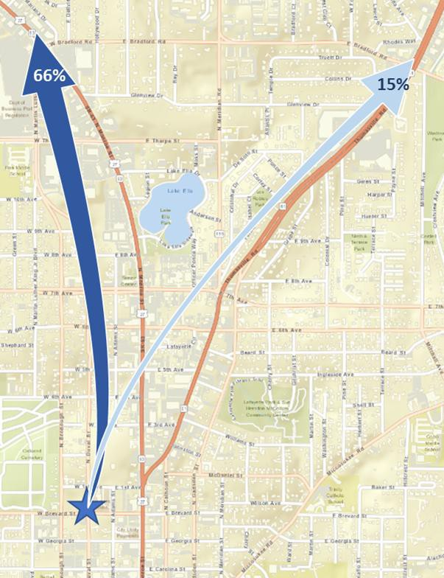
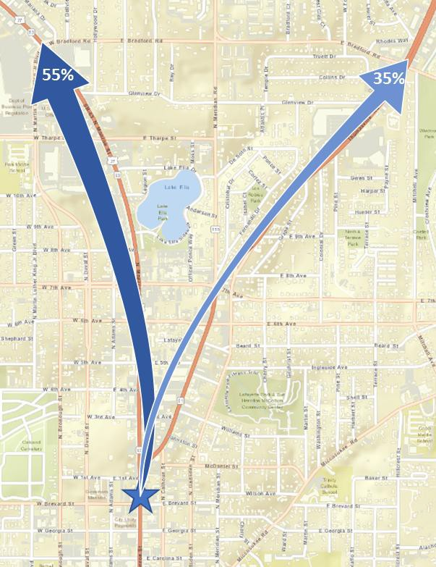
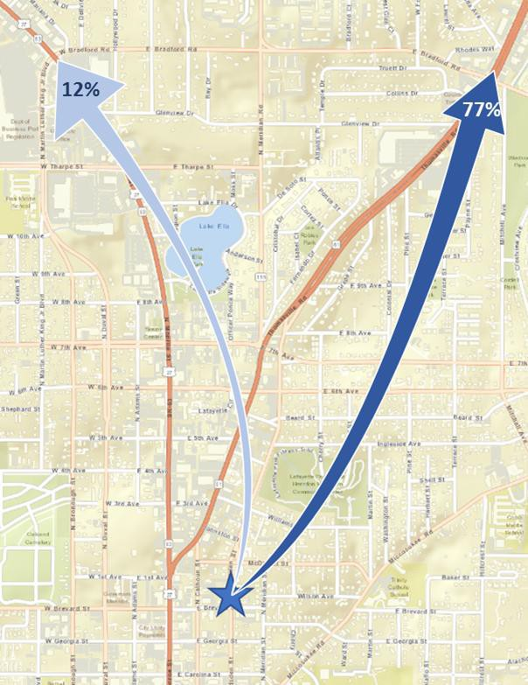
PM Peak Patterns (weekday)
Origin West of N Monroe St
Origin Along N Monroe St
Origin East of N Monroe St

Slide 8
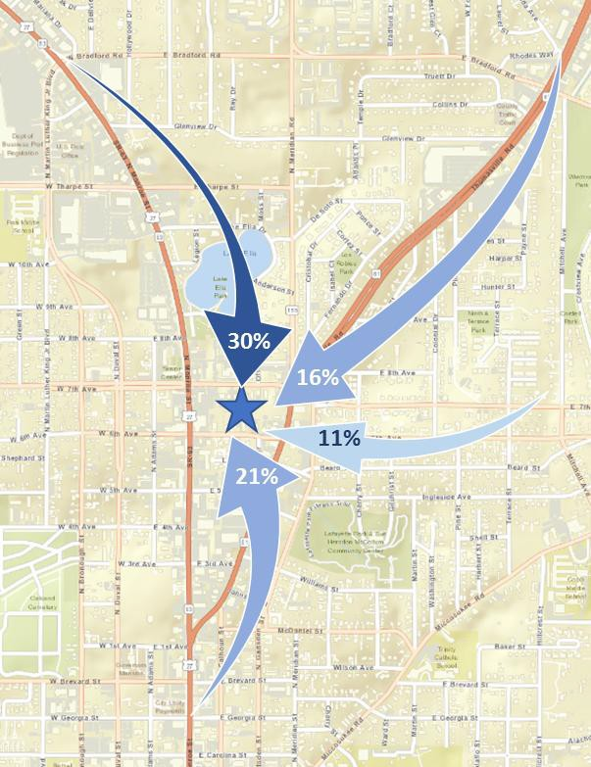
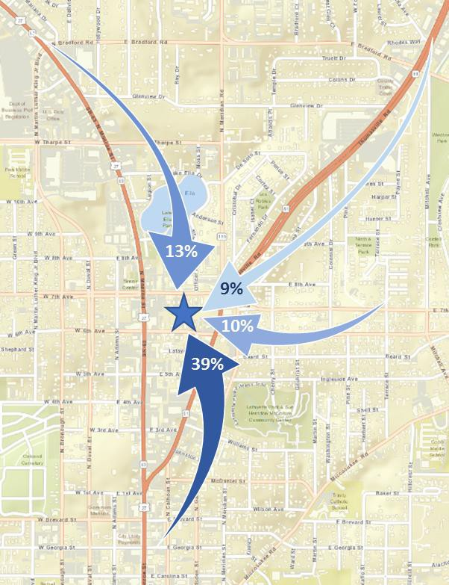
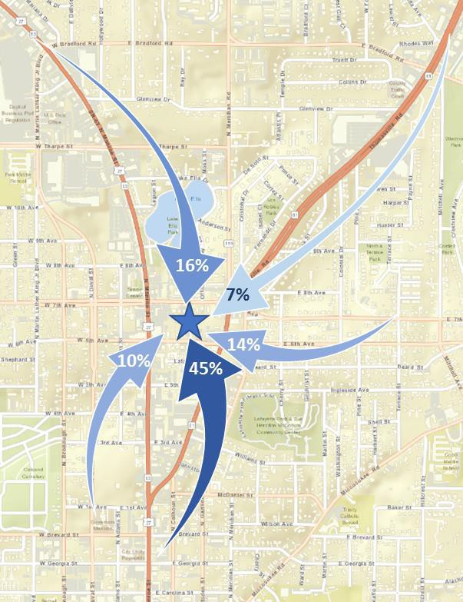
Midtown as a Destination (weekday)
AM Peak Traffic Patterns
Midday Peak Traffic Patterns
PM Peak Traffic Patterns

Slide 9
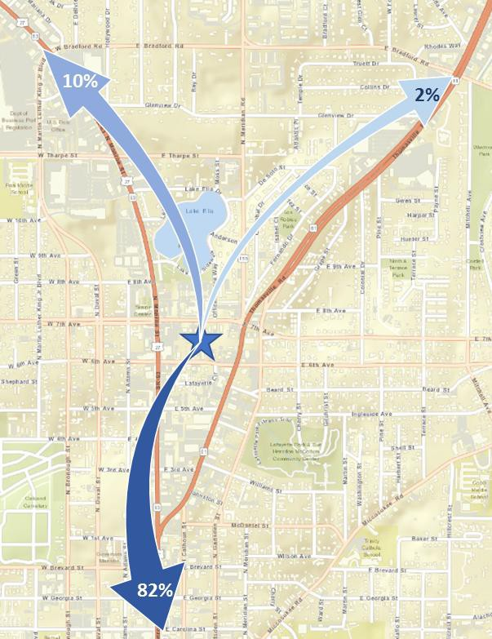
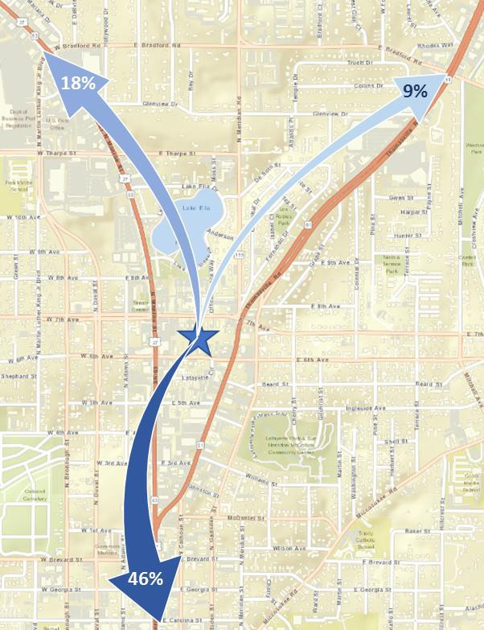
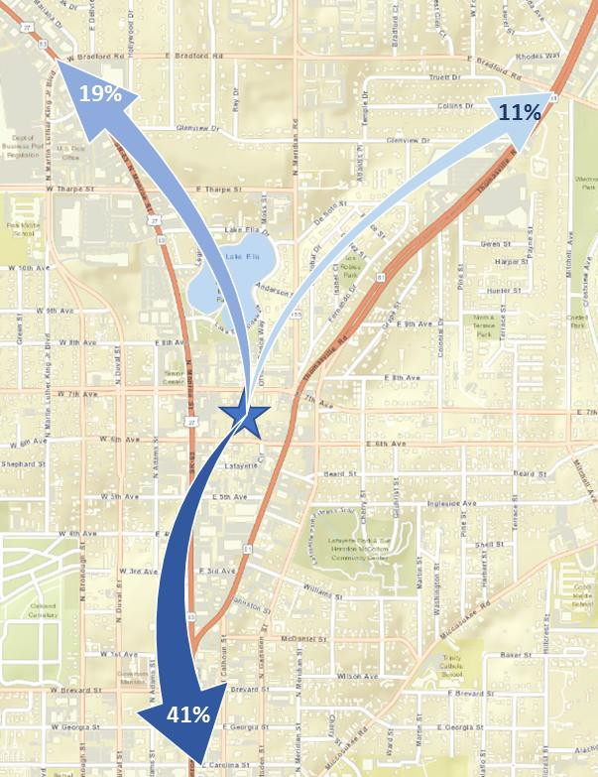
Midtown as a Origin (weekday)
AM Peak Traffic Patterns
Midday Peak Traffic Patterns
PM Peak Traffic Patterns

Slide 10
Options Being Considered
Beard St and North Gadsden St Realignment
Sidewalk Connectivity
North Gadsden St corridor improvements from 6th Ave to Thomasville Rd
Placemaking/Complete Streets
One-way southbound of Thomasville Rd from N Gadsden St to N Monroe St
One-way southbound of Thomasville Rd from N Gadsden St to 6th Ave
Thomasville, Meridian and N Gadsden Roundabout (includes all existing movements)
Thomasville, Meridian and N Gadsden Roundabout (No Gadsden to Meridian movement)
6th and 7th Ave Bi-Directional Roadways

Slide 11
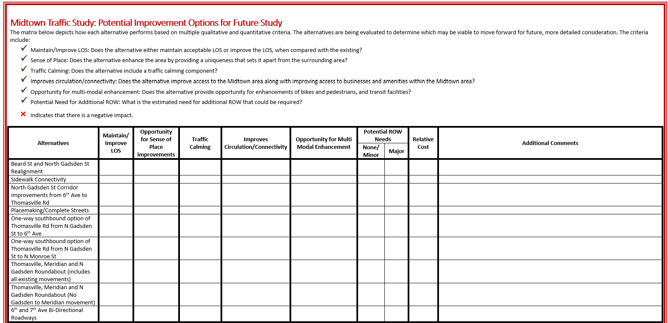

Slide 12
Options Being Considered
Beard St and North Gadsden St Realignment
Sidewalk Connectivity
North Gadsden St corridor improvements from 6th Ave to Thomasville Rd
Placemaking/Complete Streets
One-way southbound of Thomasville Rd from N Gadsden St to N Monroe St
One-way southbound of Thomasville Rd from N Gadsden St to 6th Ave
Thomasville, Meridian and N Gadsden Roundabout (includes all existing movements)
Thomasville, Meridian and N Gadsden Roundabout (No Gadsden to Meridian movement)
6th and 7th Ave Bi-Directional Roadways

Slide 13
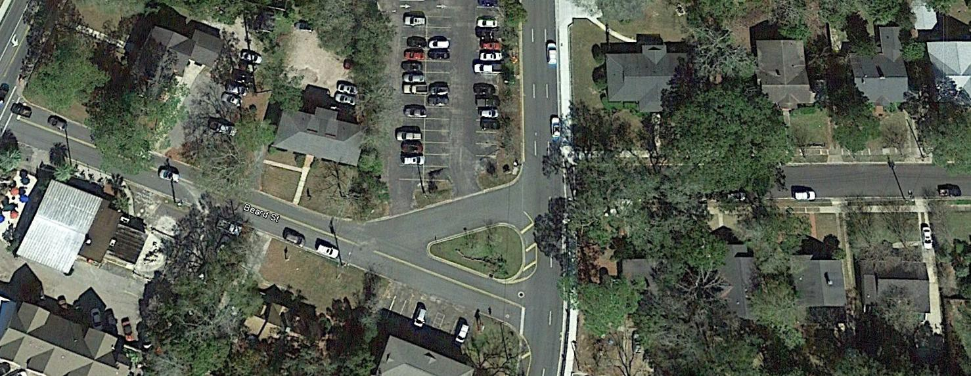
Realignment of Beard Street

Slide 14
Realignment of Beard Street

Slide 15
Options Being Considered
Beard St and North Gadsden St Realignment
Sidewalk Connectivity
North Gadsden St corridor improvements from 6th Ave to Thomasville Rd
Placemaking/Complete Streets
One-way southbound of Thomasville Rd from N Gadsden St to N Monroe St
One-way southbound of Thomasville Rd from N Gadsden St to 6th Ave
Thomasville, Meridian and N Gadsden Roundabout (includes all existing movements)
Thomasville, Meridian and N Gadsden Roundabout (No Gadsden to Meridian movement)
6th and 7th Ave Bi-Directional Roadways

Slide 16
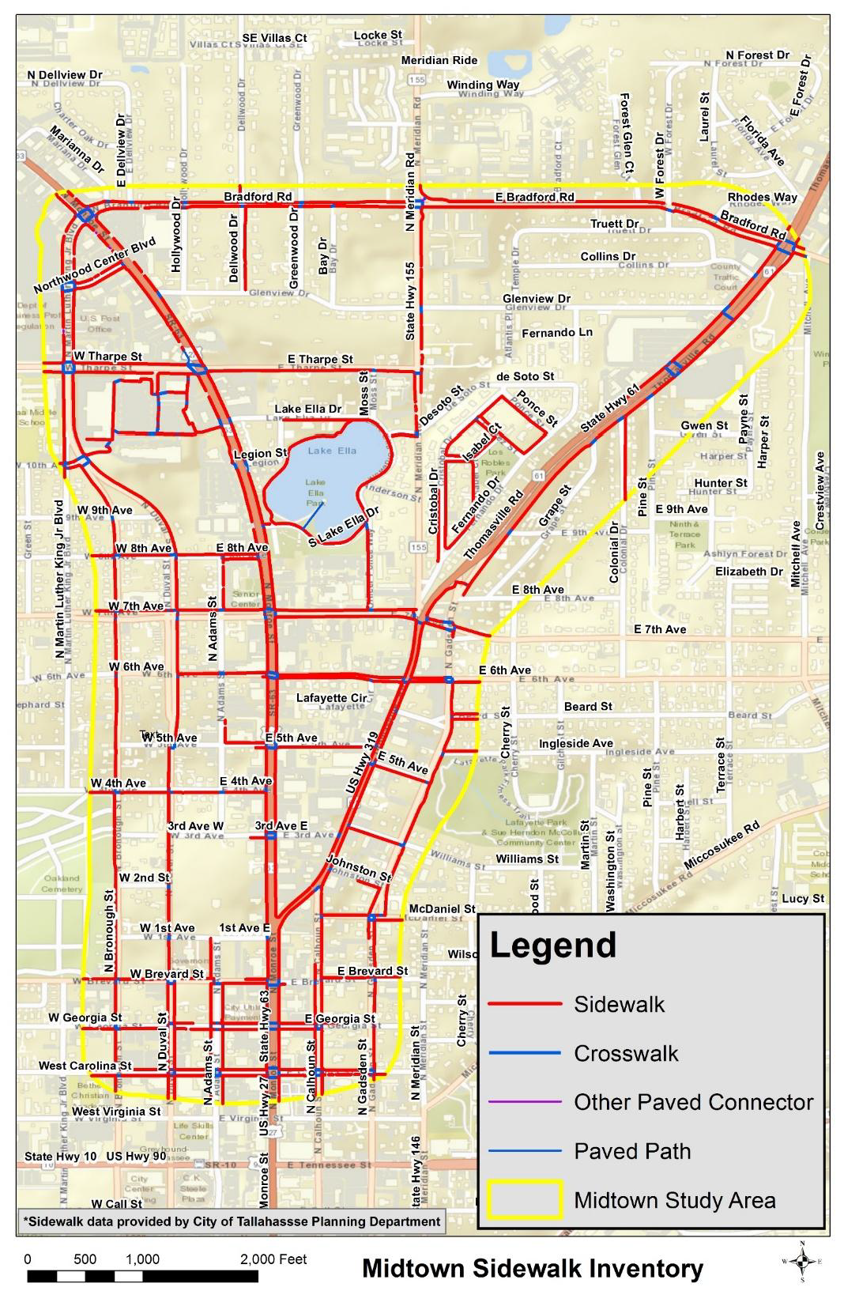
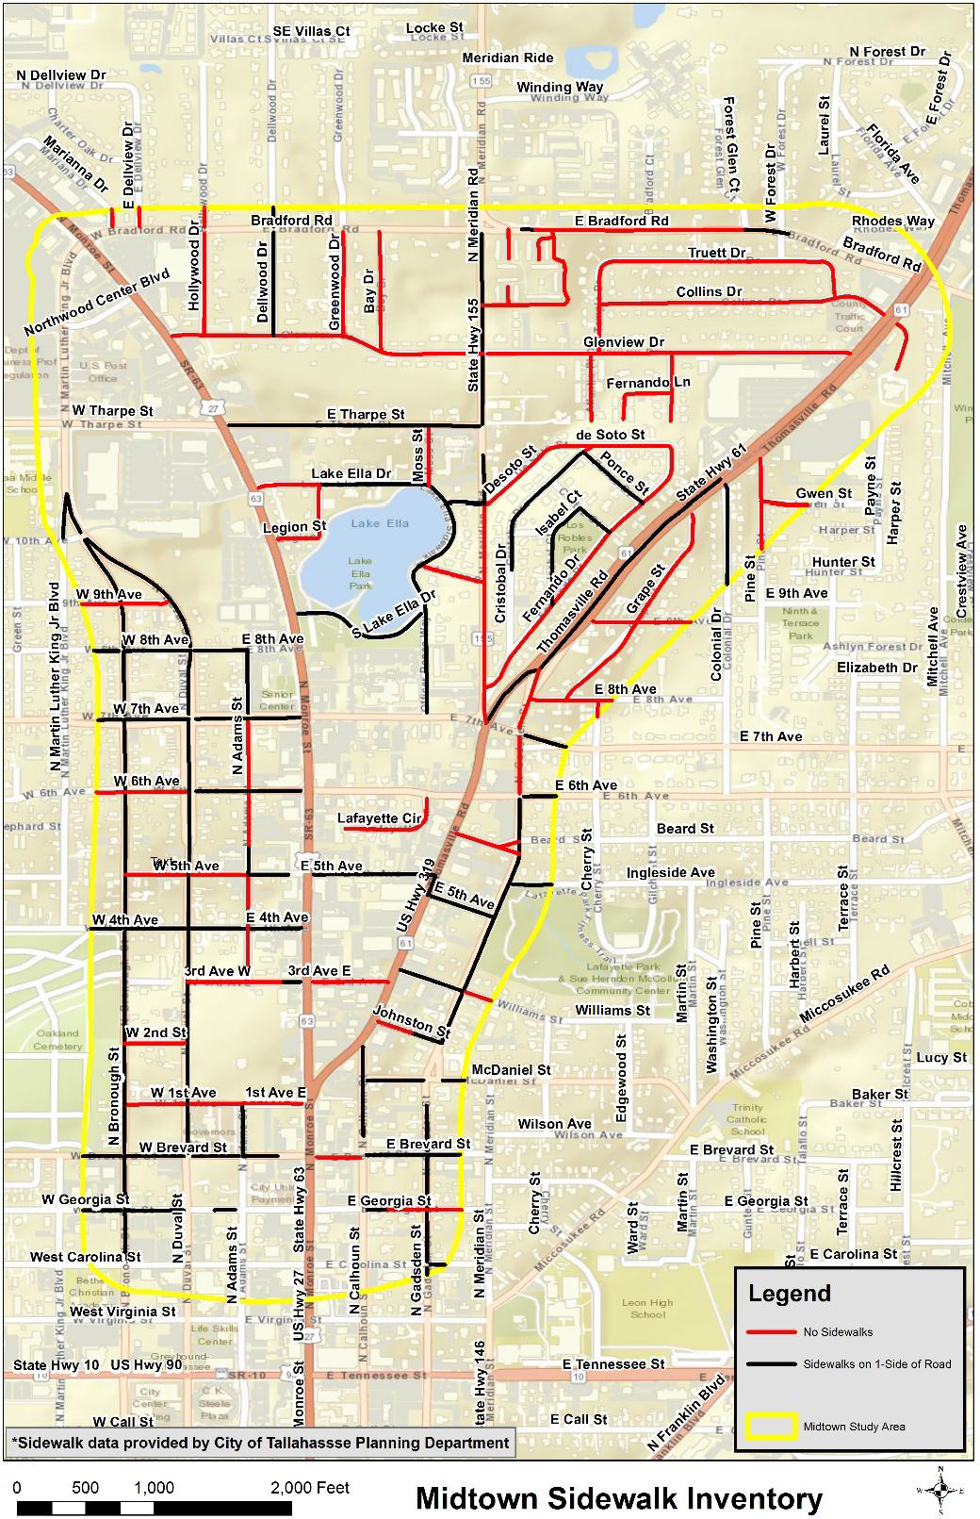

Slide 17
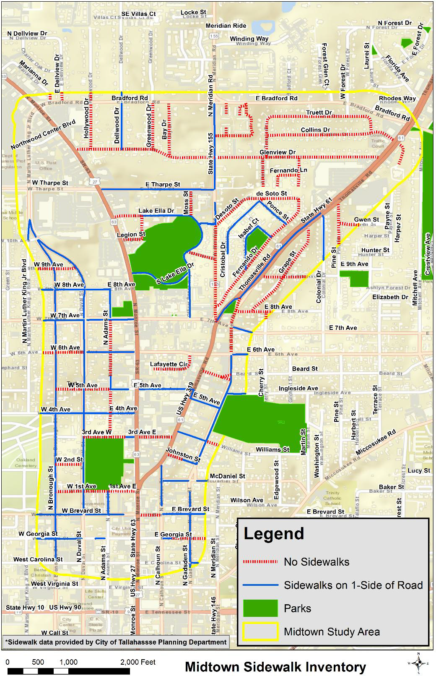
Key Gaps in Sidewalks
Thomasville Rd - Colonial Dr. to 7th Ave (west side only)
3rd, 5th, 6th, 7th Avenue
Meridian Rd
N Gadsden St

Slide 18
Options Being Considered
Beard St and North Gadsden St Realignment
Sidewalk Connectivity
North Gadsden St corridor improvements from 6th Ave to Thomasville Rd
Placemaking/Complete Streets
One-way southbound of Thomasville Rd from N Gadsden St to N Monroe St
One-way southbound of Thomasville Rd from N Gadsden St to 6th Ave
Thomasville, Meridian and N Gadsden Roundabout (includes all existing movements)
Thomasville, Meridian and N Gadsden Roundabout (No Gadsden to Meridian movement)
6th and 7th Ave Bi-Directional Roadways

Slide 19
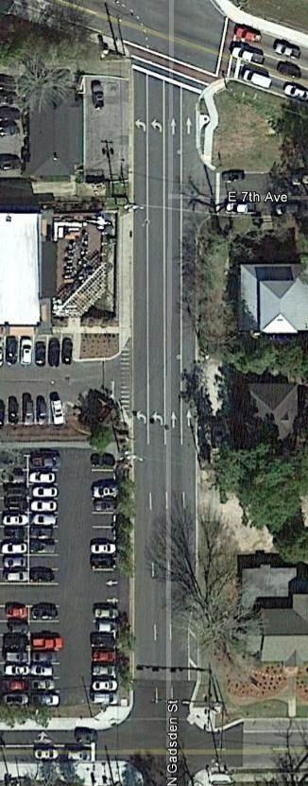
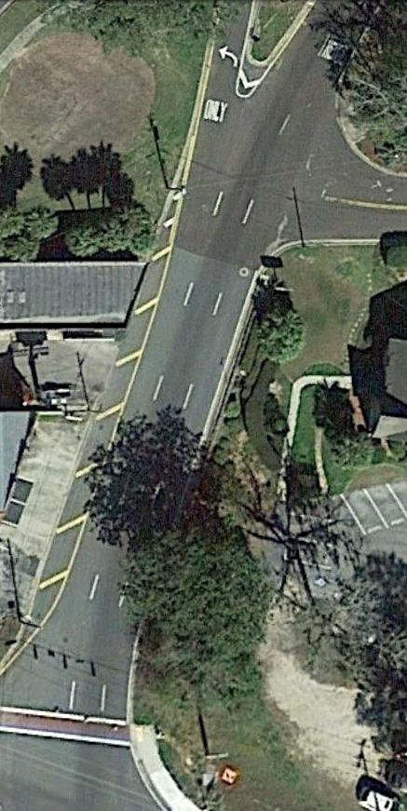
N Gadsden Between 6th Ave and 7th Ave
N Gadsden Between 7th Ave and Thomasville Rd
Sidewalk Improvements

Slide 20
N Gadsden Between 6th Ave and 7th Ave
N Gadsden Between 7th Ave and Thomasville Rd

Slide 21
Options Being Considered
Beard St and North Gadsden St Realignment
Sidewalk Connectivity
North Gadsden St corridor improvements from 6th Ave to Thomasville Rd
Placemaking/Complete Streets
One-way southbound of Thomasville Rd from N Gadsden St to Monroe St
One-way southbound of Thomasville Rd from N Gadsden St to 6th Ave
Thomasville, Meridian and N Gadsden Roundabout (includes all existing movements)
Thomasville, Meridian and N Gadsden Roundabout (No Gadsden to Meridian movement)
6th and 7th Ave Bi-Directional Roadways

Slide 22
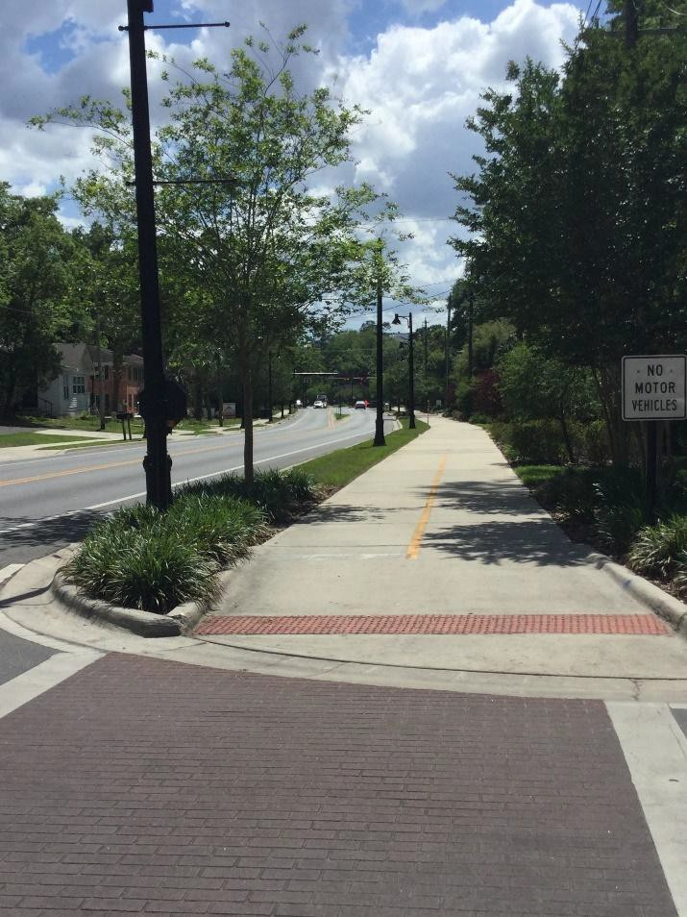
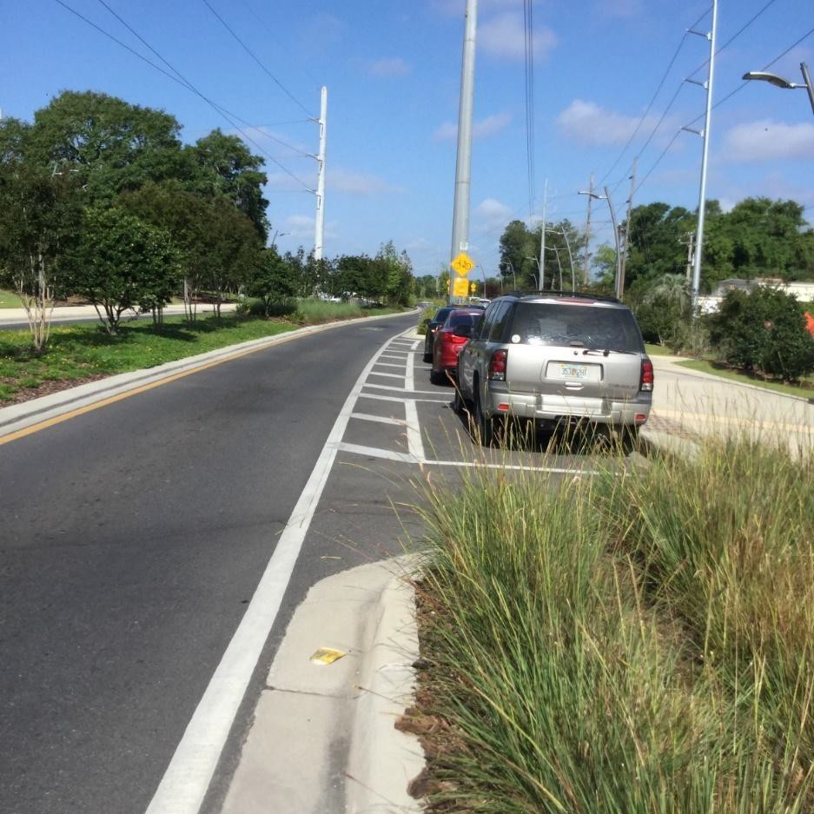
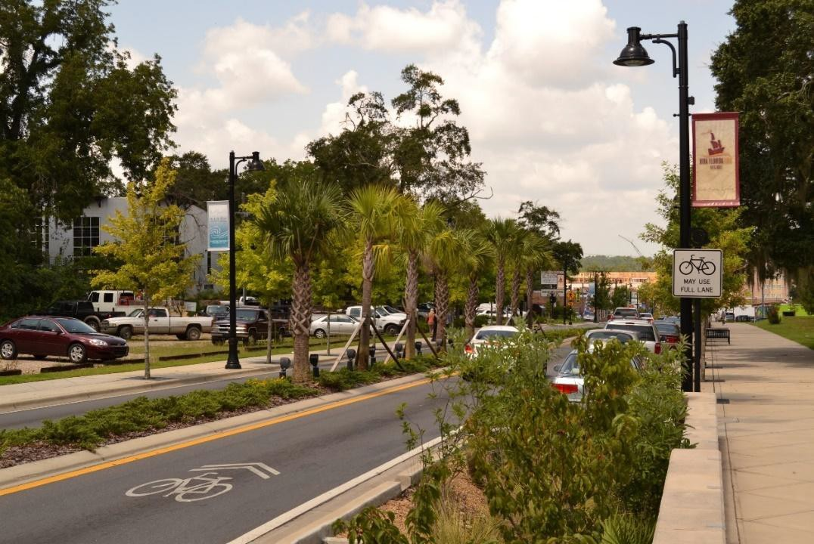
Placemaking/Complete Streets
Franklin Blvd
FAMU Way
Gaines St

Slide 23
Options Being Considered
Beard St and North Gadsden St Realignment
Sidewalk Connectivity
North Gadsden St corridor improvements from 6th Ave to Thomasville Rd
Placemaking/Complete Streets
One-way southbound option of Thomasville Rd from N Gadsden St to Monroe St
One-way southbound option of Thomasville Rd from N Gadsden St to 6th Ave
Thomasville, Meridian and N Gadsden Roundabout (includes all existing movements)
Thomasville, Meridian and N Gadsden Roundabout (No Gadsden to Meridian movement)
6th and 7th Ave Bi-Directional Roadways

Slide 24
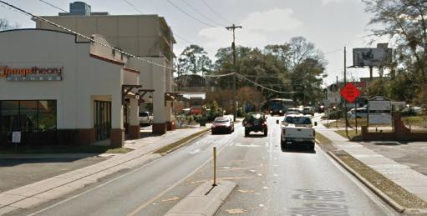
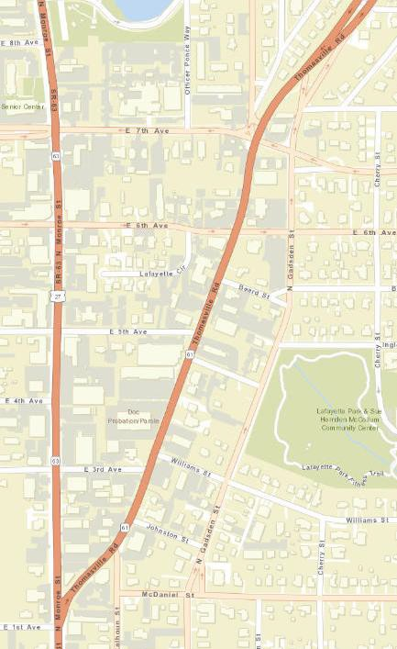
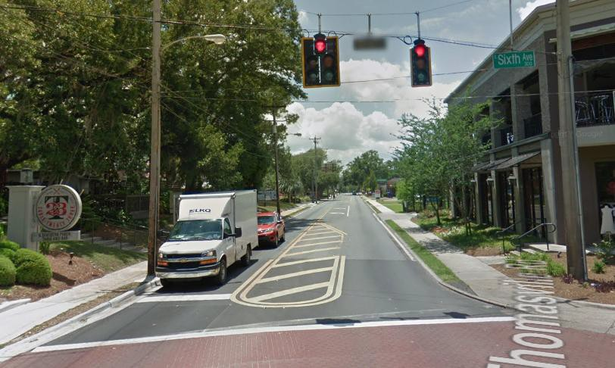
Southbound Thomasville South of 7th Ave
Southbound Thomasville at 6th Ave

Slide 25
Options Being Considered
Beard St and North Gadsden St Realignment
Sidewalk Connectivity
North Gadsden St corridor improvements from 6th Ave to Thomasville Rd
Placemaking/Complete Streets
One-way southbound of Thomasville Rd from N Gadsden St to Monroe St
One-way southbound of Thomasville Rd from N Gadsden St to 6th Ave
Thomasville, Meridian and N Gadsden Roundabout (includes all existing movements)
Thomasville, Meridian and N Gadsden Roundabout (No Gadsden to Meridian movement)
6th and 7th Ave Bi-Directional Roadways

Slide 26
Southbound Thomasville South of 7th Ave
Southbound Thomasville at 6th Ave

Slide 27
Options Being Considered
Beard St and North Gadsden St Realignment
Sidewalk Connectivity
North Gadsden St corridor improvements from 6th Ave to Thomasville Rd
Placemaking/Complete Streets
One-way southbound of Thomasville Rd from N Gadsden St to Monroe St
One-way southbound of Thomasville Rd from N Gadsden St to 6th Ave
Thomasville, Meridian and N Gadsden Roundabout (includes all existing movements)
Thomasville, Meridian and N Gadsden Roundabout (No Gadsden to Meridian movement)
6th and 7th Ave Bi-Directional Roadways

Slide 28
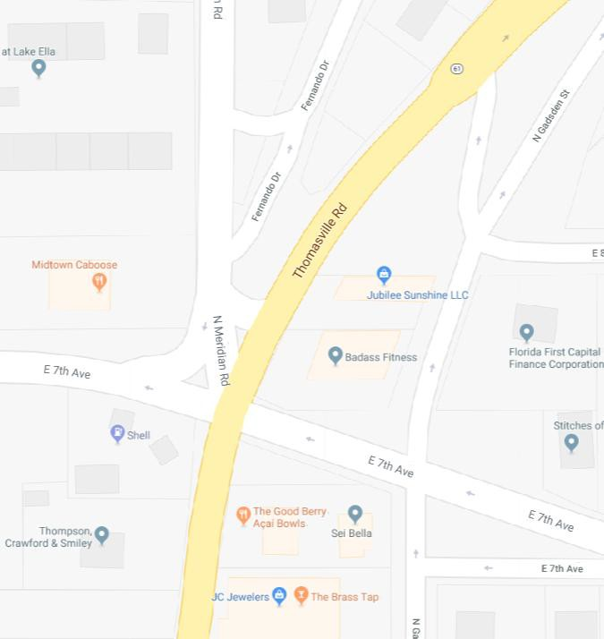
Operationally Does Not Work

Slide 29
Options Being Considered
Beard St and North Gadsden St Realignment
Sidewalk Connectivity
North Gadsden St corridor improvements from 6th Ave to Thomasville Rd
Placemaking/Complete Streets
One-way southbound of Thomasville Rd from N Gadsden St to Monroe St
One-way southbound of Thomasville Rd from N Gadsden St to 6th Ave
Thomasville, Meridian and N Gadsden Roundabout (includes all existing movements)
Thomasville, Meridian and N Gadsden Roundabout (No Gadsden to Meridian movement)
6th and 7th Ave Bi-Directional Roadways

Slide 30
Shift Movement

Slide 31
Roundabout Evaluation
Maintenance of Traffic During Construction
Pedestrian and Bicycle Compatibility
Right of Way and Construction Costs
Elevation Change along 7th Ave
Existing Utilities

Slide 32
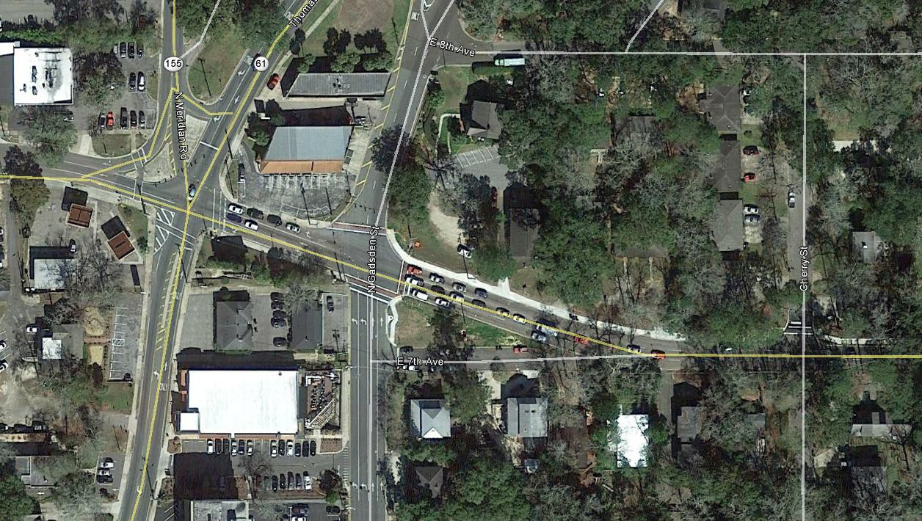
Elevation: 206 feet
Elevation: 196 feet
Elevation: 172 feet
34 feet of change over 1/8th of a mile

Slide 33
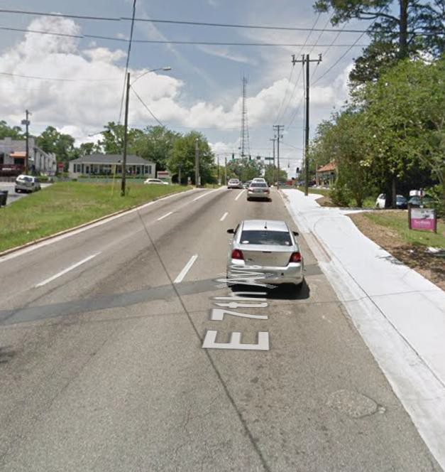
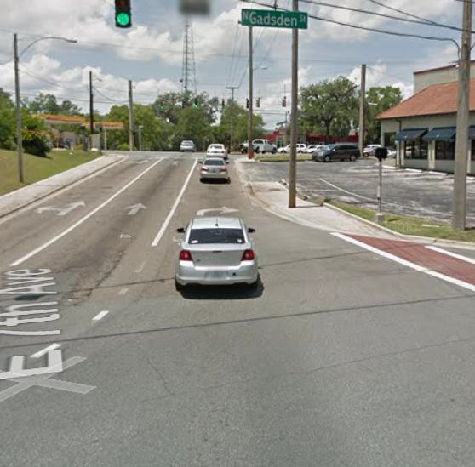
7th Ave approaching Gadsden St
7th Ave approaching Thomasville Rd

Slide 34
Options Being Considered
Beard St and North Gadsden St Realignment
Sidewalk Connectivity
North Gadsden St corridor improvements from 6th Ave to Thomasville Rd
Placemaking/Complete Street
One way southbound of Thomasville Rd from N Gadsden St to Monroe St
One way southbound of Thomasville Rd from N Gadsden St to 6th Ave
Thomasville, Meridian and N Gadsden Roundabout (includes all existing movements)
Thomasville, Meridian and N Gadsden Roundabout (No Gadsden to Meridian movement)
6th and 7th Ave Bi-Directional Roadways

Slide 35
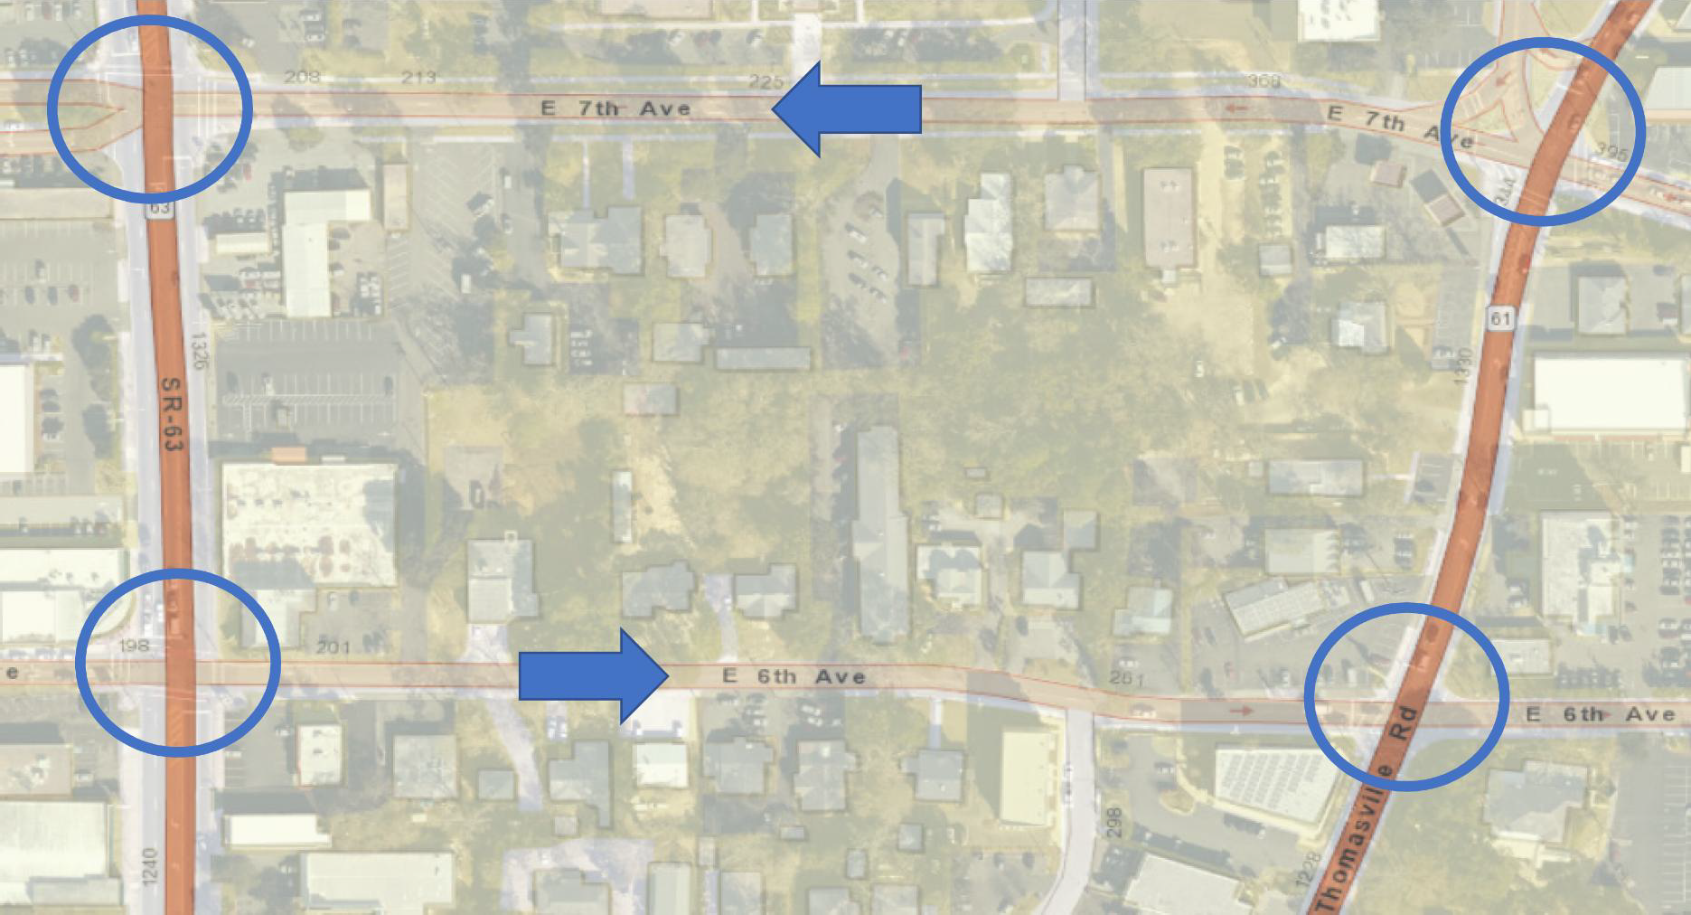

Slide 36
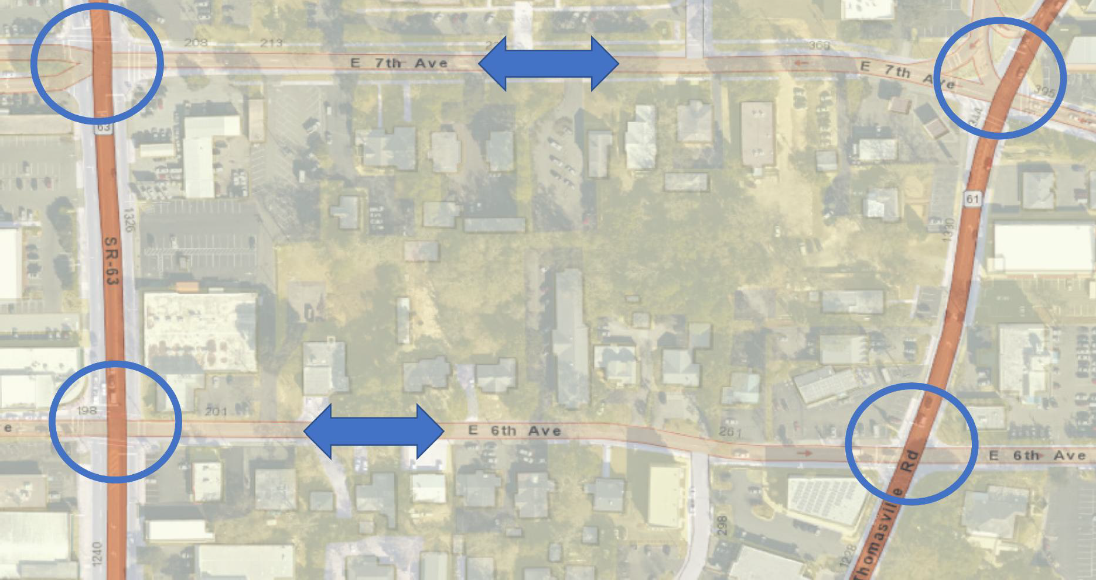
Operationally Does Not Work

Slide 37
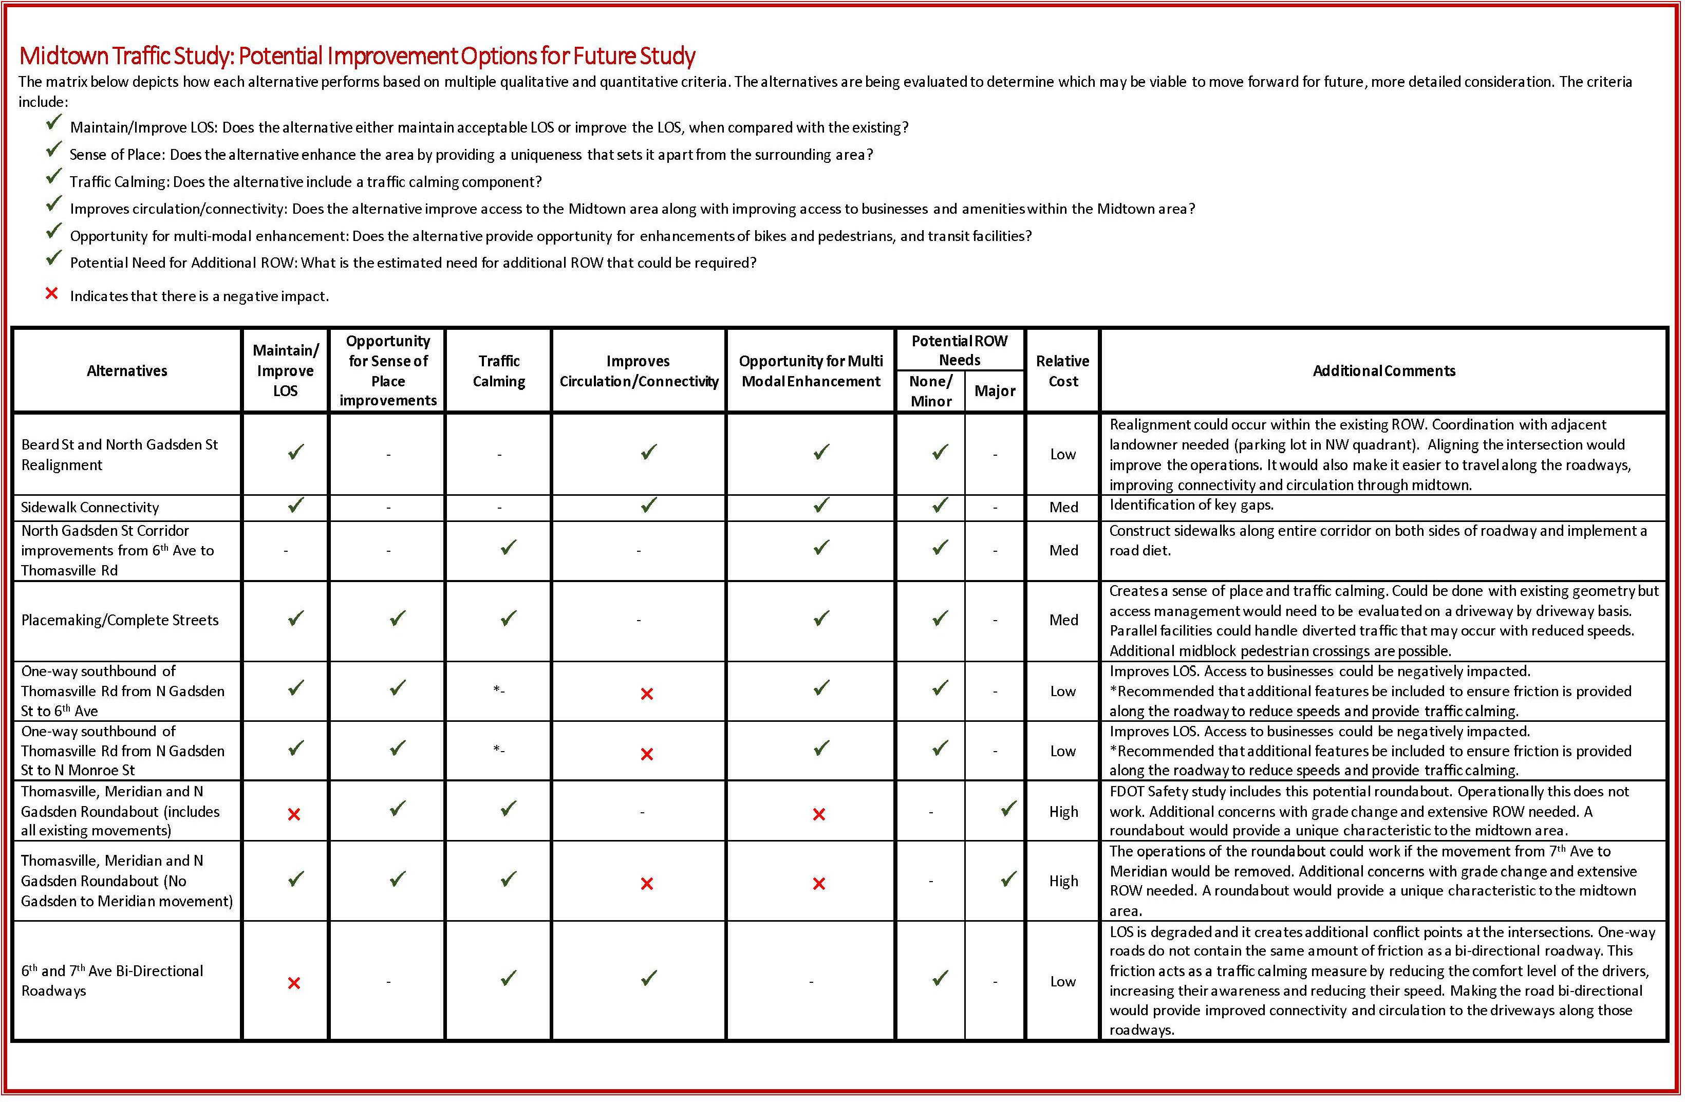

Slide 38
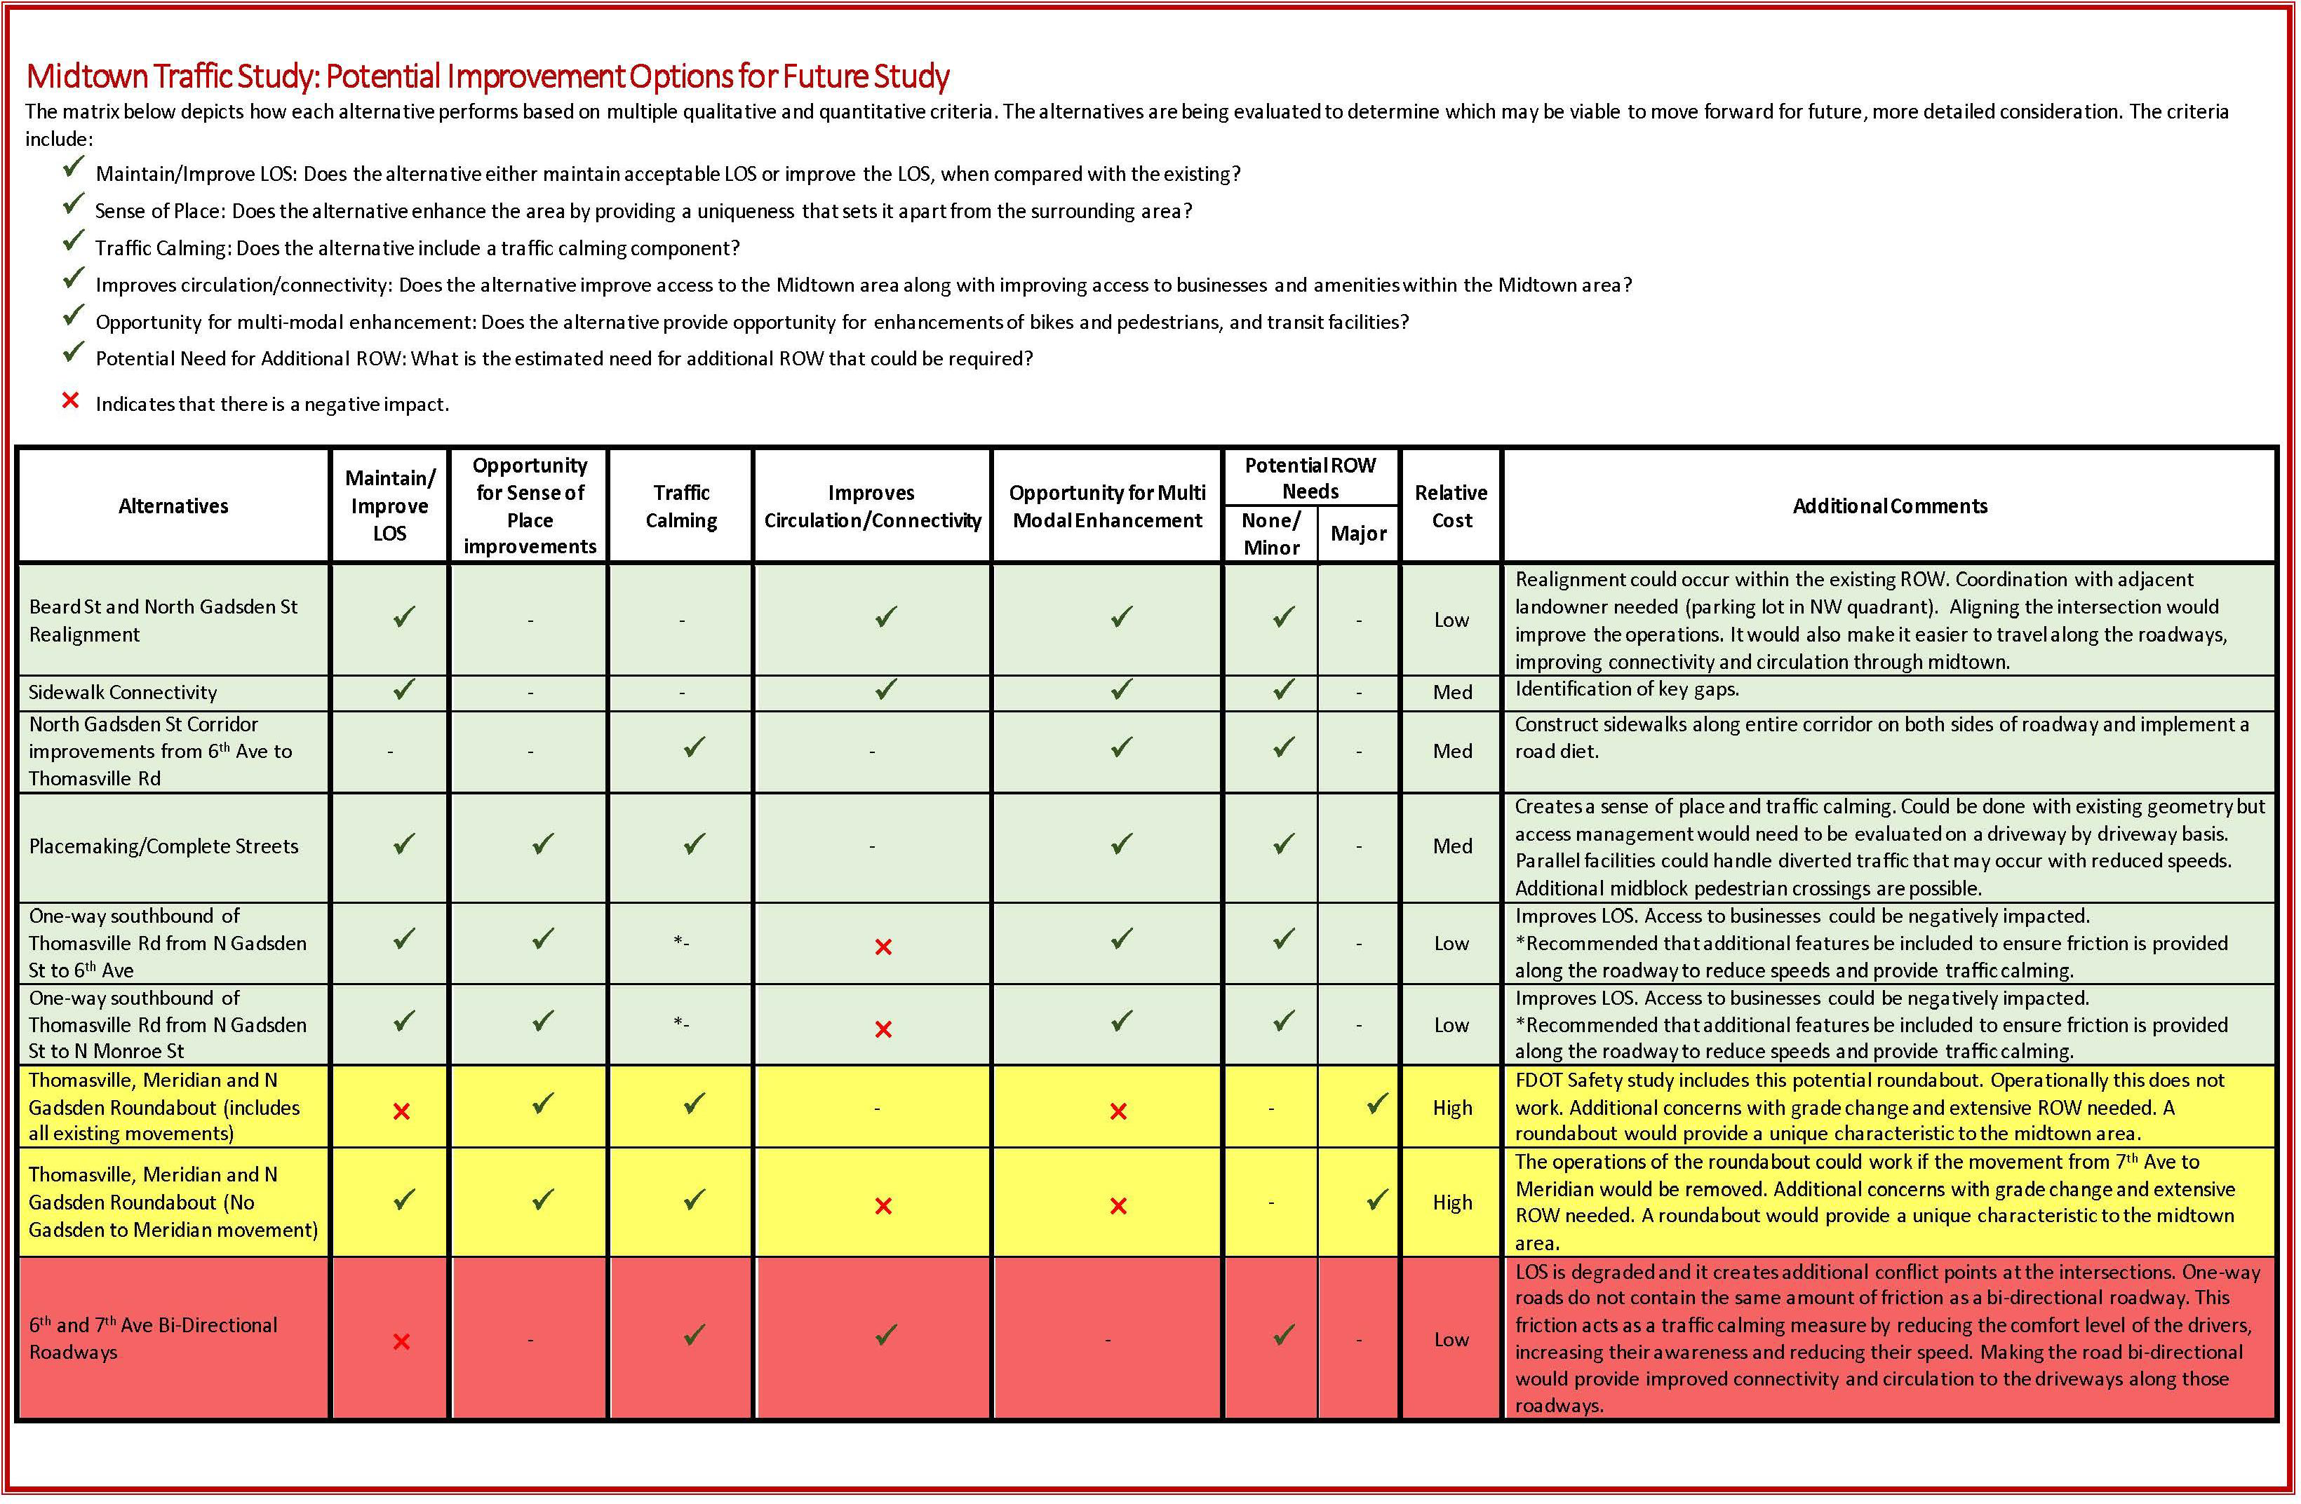

Slide 39
Phase 2
Public and Stakeholder Outreach
  Midtown Merchants, Surrounding Neighborhoods, and others
Refine alternatives evaluation and develop Midtown Transportation Plan
Evaluations specific to other modes—pedestrian, bicycle, and transit facilities
Subsequent Phases
Revise plan in response to other projects
Develop phasing and implementation strategies
Further development and design of alternatives

Slide 40

Questions/Discussion

Slide 41
